Slide 1

Predicting Used Car Prices
Created by: Denise Dodd
Notes:
Hi! My name is Denise Dodd. In this presentation I will be showing a potential used car buyer how to train a predictive model to predicted used car prices and determine which features have the greatest impact on the price of used cars.

Slide 2
Problem Statement
Problem:
Solution:
-Used car buying process can be frustrating and disheartening experience.
-Leave feeling you were taken advantage of and paid too much.
-Leave feeling you had extra money to spend and didn’t get all the features you had hoped for.
-Predictive model generated estimated selling price of a used car with specific features.
-Feature importance detailing which features impact the price the most.
-Correlation matrix detailing which numeric variables move in the same and opposite direction as selling price.
Result:
-Buyer is empowered to create a budget, select desired features, and negotiate for a value they feel is fair.
Notes:
What is the problem that we’ll be solving in this presentation?
The used car buying process is a very opaque process which can leave the buyer feeling taken advantage of and that they paid too much for their used car or the car they purchased didn’t have all of the features that they had hoped for.
Solution: In this presentation I will show the buyer how to train a model to predict an estimated selling price of a used car based on the user input of desired features. I will also show which features weigh the heaviest in the model and how they correlate to the sales price so the user can adjust their desired criteria as necessary to fit within their budget.
As a result of this, the buyer will be empowered to create a budget, select desired features, and negotiate for a value they feel is fair.

Slide 3
The Data
For this example, I will be using a dataset detailing 12 variables of over 8,000 used cars.
You will need to ethically source a comparable dataset of used cars in your locality that have sold in the current market.
In my dataset, the currency of the sale_price variable is unknown. In your dataset, you will want to ensure that you are aware of the units of measurement for each of your variables.
Notes:
The first step will be to obtain a dataset. For this example, I will be using a dataset with 12 variables detailing over 8,000 used cars. To replicate this study, a user will need to ethically source a comparable dataset of used cars in the locality and economic market which they will be purchasing. In the dataset utilized in this presentation, the currency of the sale_price variable is unknown. It is recommended that the user is familiar with the units of measurement for each variable in their dataset to provide further context and value to that information.

Slide 4
Clean Data
Convert max_power to float.
Create col titled “make” from “name” variable then drop “name” variable.
Review for and address null values.
Create histograms of numeric variables to review spread and outliers.
Isolate numeric outliers and determine how to handle.
Create bar graphs of categorical variables to review spread and outliers.
Isolate categorical outliers and determine how to handle.

Slide 5
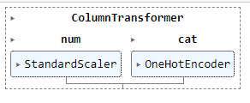
Prepare Data
Separate into features and target variables.
Create a pipeline which transforms the features columns in the following way:
Scales numeric variables
Creates dummies of categorical variables.
Further separate features and target variables into training and testing sets.
Notes:
Once my data has been cleaned, I’m going to prepare the data for my models.
The first step in preparing my data is to separate the data into features and target variables. The target variable is the variable that I am attempting to predict. In this case, I am attempting to predict the selling price of used cars so “selling price” will be my target variable. All of the other variables which I would like to use to inform the target variable will be included in my features variable.
I will then create a pipeline which will transform the features variable by scaling numeric data and making dummy variables of the categorical data. I will be scaling the numeric data because my numeric data is currently in varying units of measurement. Scaling this data will ensure that all numeric data is on a comparable scale and no one variable will “outweigh” another variable in this stage of the process. Dummy variables create binary numeric variables of categorical data. It is necessary to make dummy variables of categorical data because our models require numeric data to complete their computations.
Once the pipeline has completed its work, the features and target variables are split into testing and training sets. 80% of the data will be used to train our models and the remaining 20% will be used to test the efficiency of the models once the training is complete.

Slide 6
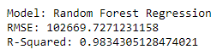
Random Forest Model
After training several models to my data, the Random Forest Model showed to be the best fit according to the following metrics:
Notes:
After fitting and making predictions on several models, the Random Forest Model showed to have the best metrics for this data. This model showed the lowest RMSE with a value of 102,669.73 indicating that on average our predictions will be off by this amount. The range of the target variable is from 29,999 to 10,000,000 so an average outage of 102,669.73 is not concerning.
The Random Forest model had an R-Squared value of .9834 meaning that 98.34% of the variance in selling price (target variable) can be explained by the model.
Initiate instance of this model outside of the loop to be accessed in the reminder of the study.

Slide 7
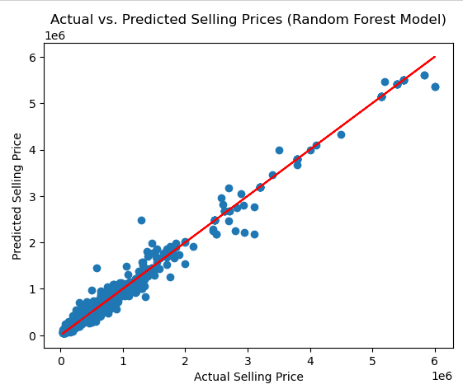
Regression Plot
Notes:
To visualize the effectiveness of the Random Forest model, this regression plot graphs the predicted sales prices vs the actual sales prices. The plots gather around the red target line indicating a high rate of accuracy with limited variance between actual prices and predicted prices. This also gives a small insight into the spread of the selling price variable. This variable is skewed to the right with more data at the lower end of the price range and outliers on the high end of the price range.

Slide 8
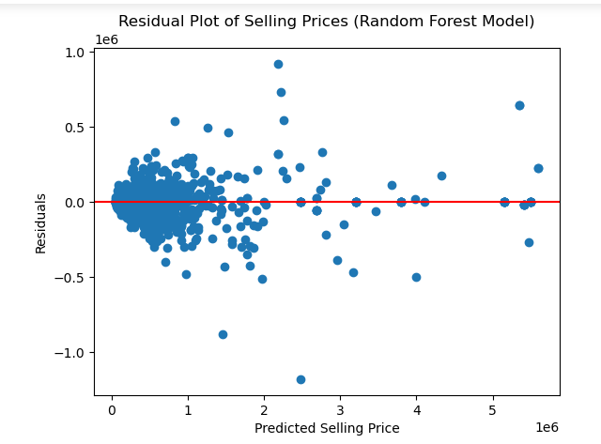
Residual Plot
Notes:
This residual plot graphs the residual amounts (the differences between the actual sales prices and the predicted sale prices) vs the values predicted by the model. The plots gather around the y-axis base line of "0" indicating that the difference between the predicted value and actual value is minimal. There appears to be an even distribution of residuals above the actual value and below the actual value.

Slide 9
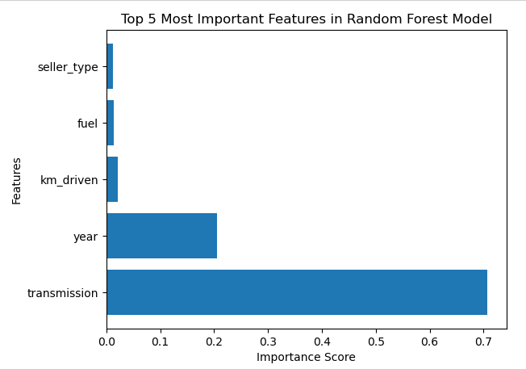
Features Importance
Notes:
The bar graph below shows how important the top 5 features are when the random forest model is predicting the selling price. The type of transmission is by far the most important feature followed by year. If one wanted to adjust the predicted selling price of a car that they’re interested in, these are the variables that would have the greatest impact in altering the selling price.

Slide 10
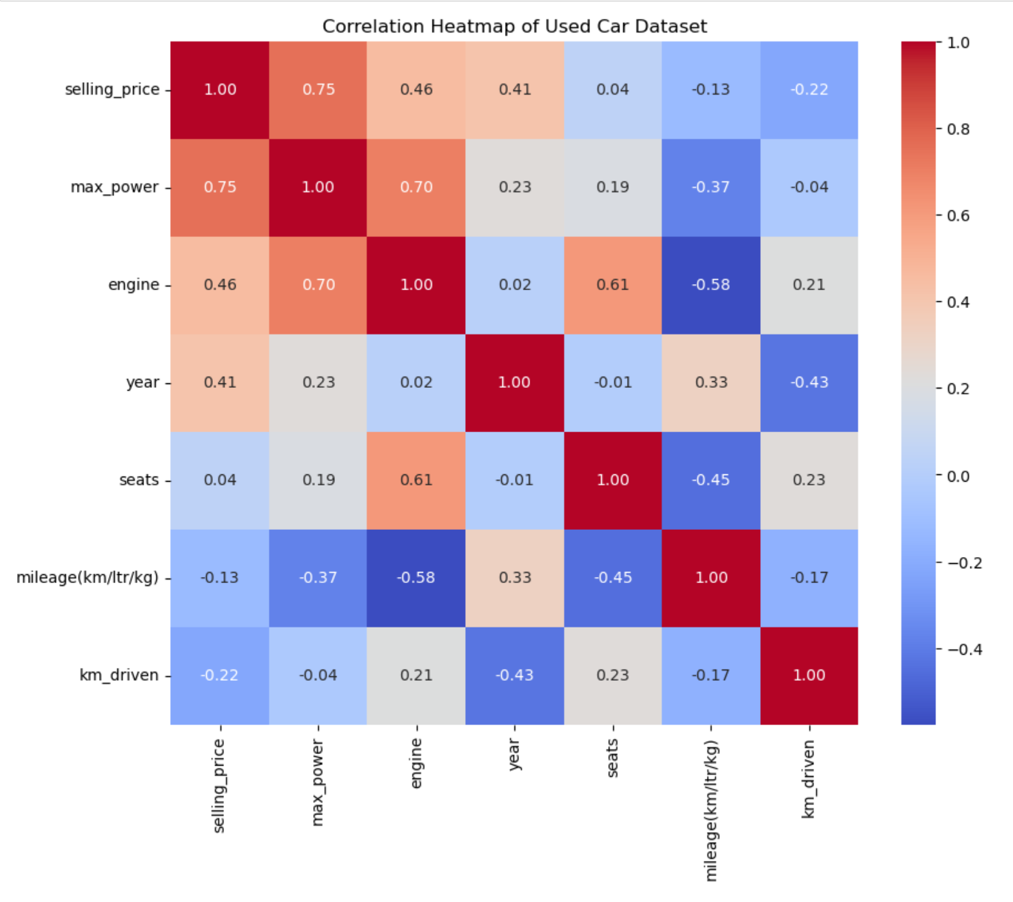
Correlation Matrix
Notes:
To further inform how one can alter their desired criteria to change the selling price, this correlation matrix shows how the numeric variables move in relation to one another. Max_power has a strong positive correlation with selling_price at .75 indicating that max_power and selling_price tend to move together. As max_power increases, selling_price will increase as well and vice versa when the variables decrease. Conversely, km_driven has a -.22 correlation with selling_price. This is a weaker negative correlation, indicating that as km_driven decreases selling_price will increase and vice versa.

Slide 11
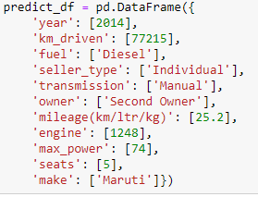
Recomendations
Establish budget and desired characteristics.
Create several different entries in predictive dataframe with a variety of characteristics.
If you have a specific car in mind that you’ve already found enter the specific characteristics of that car.
Use features importance and correlation matrix to determine ho you would like to vary characteristics.
Notes:
Before deploying this model, it is recommended that an individual create a range for their budget and desired characteristics for the used car they want to purchase. A predetermined range will help the buyer know how far they’re willing to alter their characteristics to stay on budget. For example, the budget is 500,000-600,000 and the range for the year that their car was made is between 2010 and 2020. When the predictive data frame is filled in with a year of 2015 and the predicted price is 450,000 which is less than their budget, the buyer knows they have the option to update the predictive dataframe to represent a year value of 2020 and include all the benefits of a more modern car.
Once a range has been determined for the budget and the features variables, it is recommended that the buyer creates a predictive dataframe with several different entries representing a variety of cars in which they would be willing to purchase. They can then run the predictive dataframe through the transformation pipeline and random forest model to obtain the predicted prices of the cars described in the predictive dataframe.

Slide 12
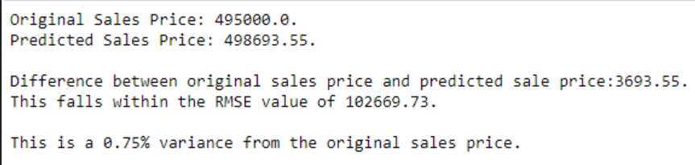
Implementation
Run columns through pipeline and make predictions.
To demonstrate efficiency, I created a predictive dataframe that was equivalent to an entry in the original dataframe and calculated the difference between my predicted value and the value that the matching car in the original dataframe sold for:
Notes:
Once you’ve created a predictive dataframe with several entries based on your predetermined budgets and desired characteristics, you can pass that predictive dataframe through the transformative pipelines and then make predictions of the selling price using the previously trained random forest model.
To demonstrate efficiency, my predictive dataframe had an entry that matched one of the entries in the original dataframe. The random forest model returned a predicted sale price of 498,693 for this car while the car in the original data frame sold for 495,000. This is a difference in selling price of 3,693 which represents a .75% variance.

Slide 13
Challenges
As noted when describing the data, the user will have to source their own set of data detailing used cars.
User will want to ensure that the data set they use is:
Ethically sourced and contains no private information pertaining to the buyers and sellers.
Representative of current used car market
Only includes cars from the locality which they are looking to buy
Include units of measurement
Notes:
I believe the largest challenge one might have when replicating this project will be obtaining a viable dataset.
As noted when describing the data, the user will have to source their own dataset detailing used cars in their current local used car economy. This dataset will have to be ethically sourced and should not include any personal information pertaining to the buyer or sellers of the cars in the dataset.

Slide 14
Additional Uses
Auto Dealerships
Individual Sellers
Notes:
The goal of this presentation is to empower an independent used car buyer to be more knowledgeable when engaging with sellers.
However, other uses for this could include an auto dealership who would like to offer this as a service to prospective buyers in a show of transparency.
Additionally, sellers can utilize this model to ensure that they are pricing their vehicles fairly and competitively.

Slide 15
Resources
Brar, S. (2024, March 28). Car price prediction dataset. Kaggle. https://www.kaggle.com/datasets/sukhmandeepsinghbrar/car-price-prediction-dataset
D’Allegro, J. (2021, October 19). Just what factors into the value of your used car?. Investopedia. https://www.investopedia.com/articles/investing/090314/just-what-factors-value-your-used-car.asp
Duman, M. (2024). Ways to save money when creating a used car budget. Mike Duman Auto Superstore. https://mikeduman.com/blog/ways-save-money-when-creating-used-car-budget
Tucker, S. (2024, February 19). Average used car price down 4% since last year - Kelley Blue Book. Kelley Blue Book. https://www.kbb.com/car-news/averaged-used-car-price-down-4-since-last-year/

Slide 16
Thanks!
Additional Questions?
dedodd@my365.bellevue.edu
456-775-2793
https://dedodd1.wixsite.com/datascience

